Slide 1
FPGA-based Router Virtualization:
A Power Perspective
Author:
Thilan Ganegedara, Viktor K. Prasanna
Publisher:
IEEE IPDPSW, 2012
Presenter:
Li-Hsien, Hsu
Data:
12/12/2012
Notes:
Goal of this paper(first line)

Slide 2
Introduction(1/2)
In this paper, we study the effect of router virtualization, from a power consumption perspective, on the widely used Field Programmable Gate Array (FPGA) platform.

Slide 3
Introduction(2/2)
We summarize our contributions in this work as follows:
  An accurate analytical model to estimate power savings achieved using router virtualization
  Exploration of low power FPGAs to achieve greater power benefits in networking applications
  Detailed power comparison of non-virtualized vs. virtualized schemes on state-of-the-art FPGA
  Power efficiency comparison for different virtual router configurations

Slide 4
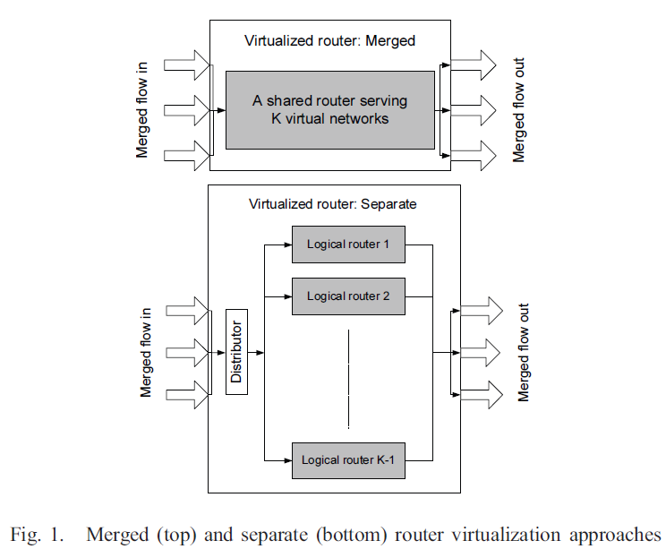
background
In the research community, two main categories of virtualization techniques can be found: 1) Separate and 2) Merged.
Notes:
畫線的下面幾句話&time sharing, space sharing

Slide 5
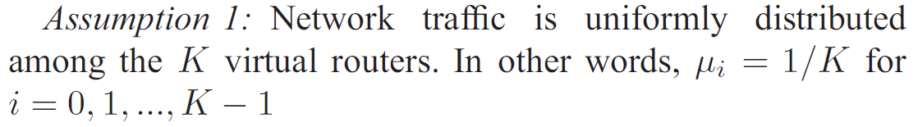
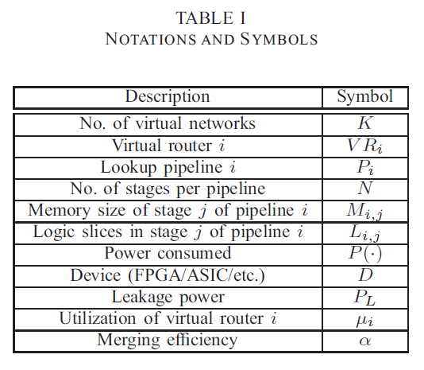
Notations & assumptions(1/4)

Slide 6
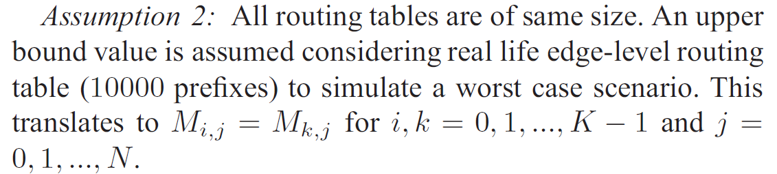
Notations & assumptions(2/4)

Slide 7
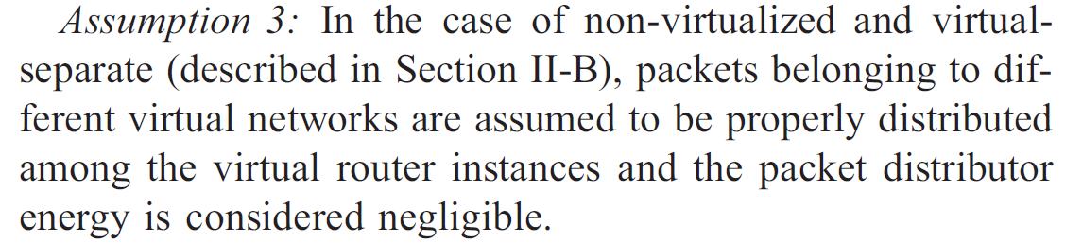
Notations & assumptions(3/4)

Slide 8
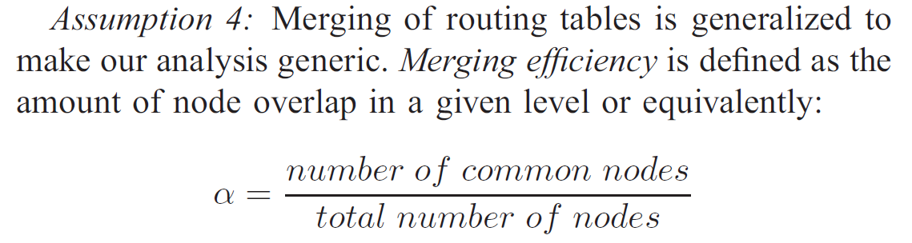
Notations & assumptions(4/4)

Slide 9
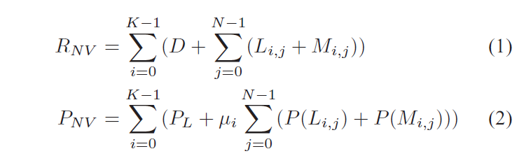
Router models for power estimation(1/3)
Non-virtualized
Notes:
即傳統

Slide 10
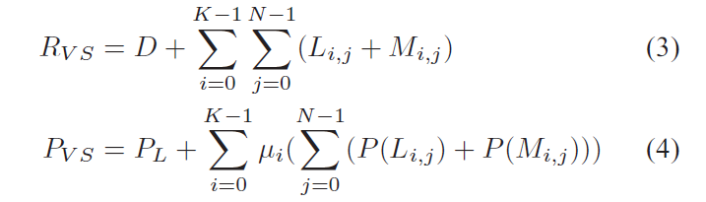
Router models for power estimation(2/3)
Virtualized-separate
Notes:
即傳統

Slide 11
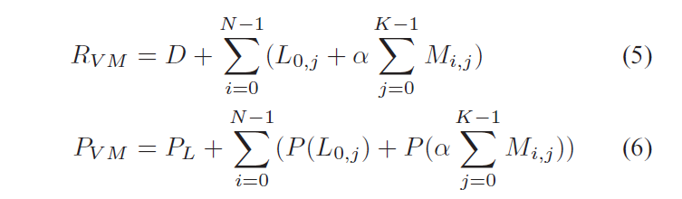
Router models for power estimation(3/3)
Virtualized-merged
Notes:
即傳統

Slide 12
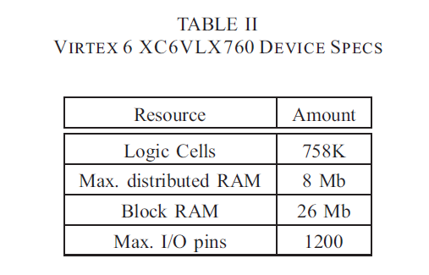
Virtual routers on FPGA(1/5)
For these experiments, we consider a Xilinx Virtex 6 platform (XC6VLX760) under two speed grade scenarios: 1) speed grade -2 for high performance and 2) speed grade -1L for lower power.

Slide 13
Virtual routers on FPGA(2/5)
Static power
  The static power is the minimum power required to keep the device “powered up” with no switching.
  it is proportional to the area of the device, process technology, and the operating temperature.
In our case, we examined the static power dissipation of the device under the two speed grades and the results are as follows:
• Speed grade -2: 4.5 ± 5% W
• Speed grade -1L: 3.1 ± 5% W

Slide 14
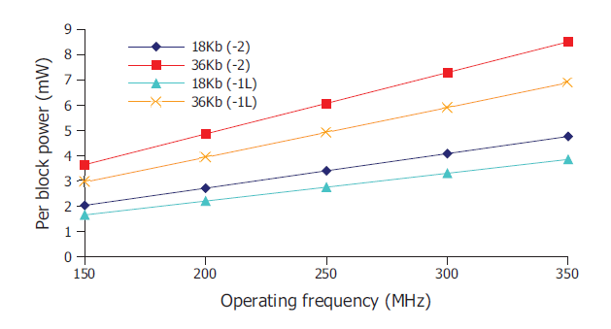
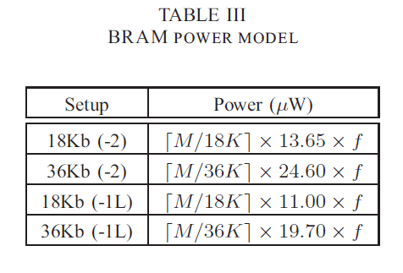
Virtual routers on FPGA(3/5)
Power consumed by memory

Slide 15
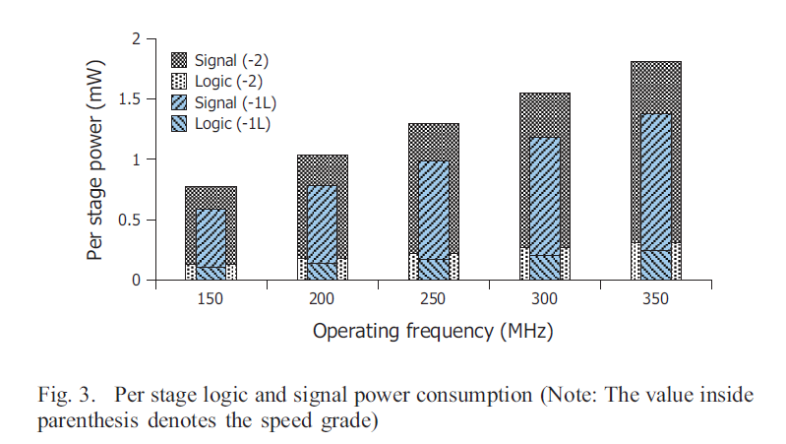
Virtual routers on FPGA(4/5)
Power consumed by logic
  Logic power is distributed among Look-Up Tables (LUT), shift registers, distributed RAM and flip-flops.
  Signal power includes the power dissipated when communicating among the aforementioned logic resources as well as memory components.

Slide 16
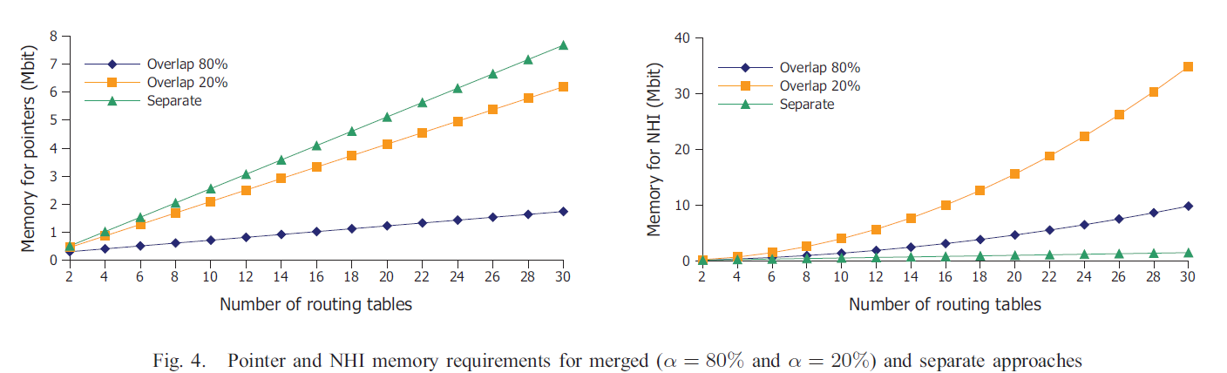
Virtual routers on FPGA(5/5)

Slide 17
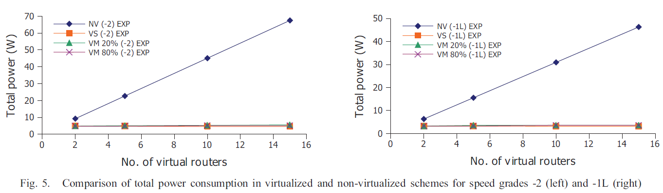
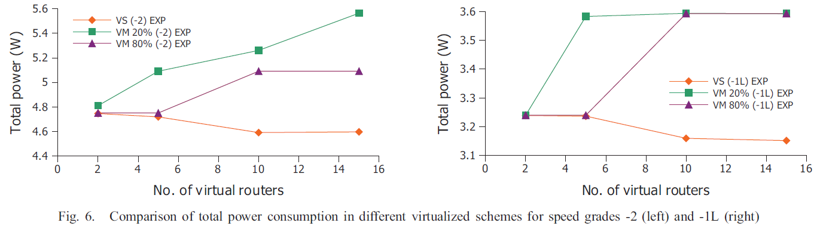
Power performance(1/3)

Slide 18
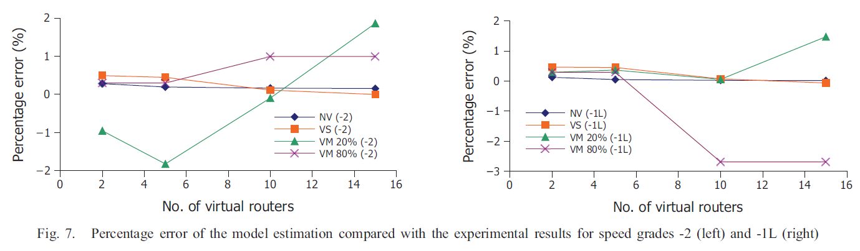

Power performance(2/3)

Slide 19
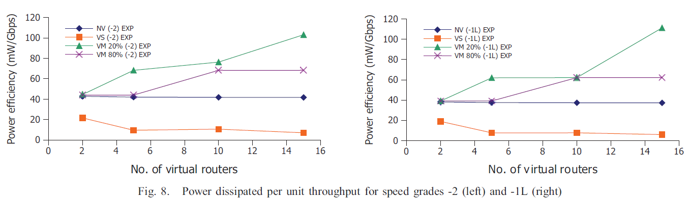
Power performance(3/3)
we use the power dissipated per unit throughput as the metric for our comparisons.
Notes:
越小越好

